Slide 1
Data Analysis

Slide 2
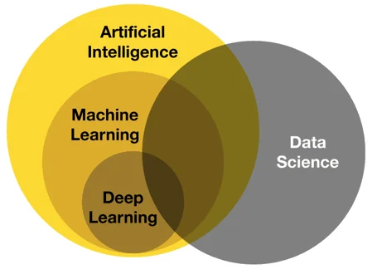
Data Science

Slide 3
Data Analysis
Plays a crucial role in data science.
Collecting raw data.
Finding patterns.
Drawing conclusions and decision making.
Requires attention to detail.

Slide 4
Data Scientist
A good data scientist must:
be able to manage information
have a substantial amount of mathematical and statistical tools.
present results in the most intuitive way.
be able to tackle the problem in a business perspective.

Slide 5
Data Scientist
Focus on the business problem.
Look into the dataset.
Apply appropriate models.
Visualization.

Slide 6
Absenteeism (A case study)
Corporate employees productivity.
Higher competitiveness: Increased pressure.
Unachievable business goals: Raised stress levels.
Elevated risk of unemployment: Raised stress levels.

Slide 7
Absenteeism (A case study) Cont.
What factors lead to employee absence from work?
Knowing beforehand can increase productivity.
Definition: Absenteeism from work during normal working hours, resulting in temporary incapacity to execute regular working activity.
Need to predict how an employee will be absent or not.

Slide 8
How to measure absenteeism?
Explore whether a person presenting certain characteristics is expected to be away from work at some point in time or not.
How far they live from workplace?
How many children and pets?
Higher education?

Slide 9
Analyze Data to predict Outcomes
Outcome is the absentee.
Identify Dependent and Independent Variables.
What variables will have more impact?
Which ones will not affect the outcome.

Slide 10
Preprocessing
Outcome is the absentee.
Identify Dependent and Independent Variables.
What variables will have more impact?
Which ones will not affect the outcome?

